Slide 1
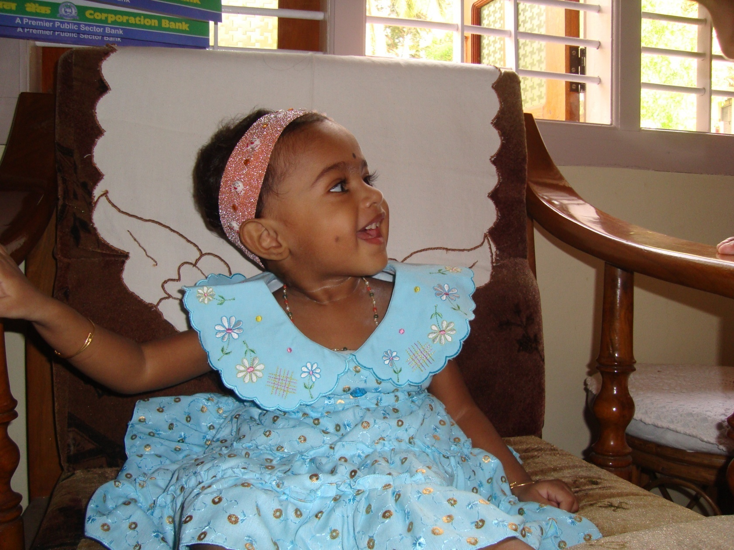
Born: April 10th 2008 Time of birth: 9.56am
Sibling: Ninad Girish Agahanshini (Brother)
Sun Sign: Aries
Left us: June 4th, 2018, she was 10yrs 2 mohths
Ishaani Girish Aghanashini

Slide 2
Her SMILE captivates us!
Ishaani our angel!

Slide 3
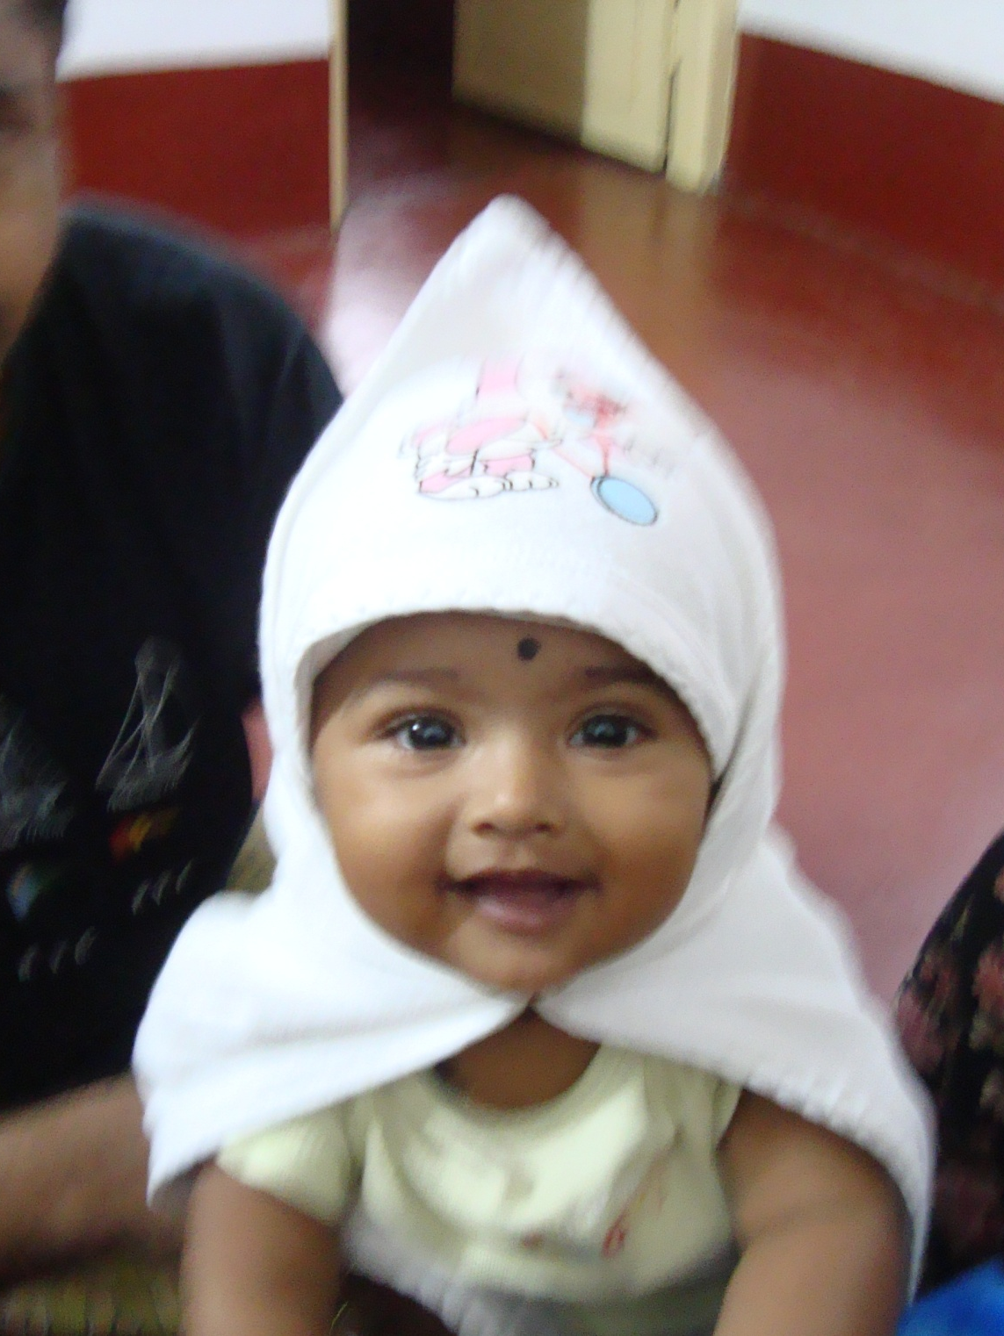
At her best, with her dad, our little darling!
Age: 6 months

Slide 4
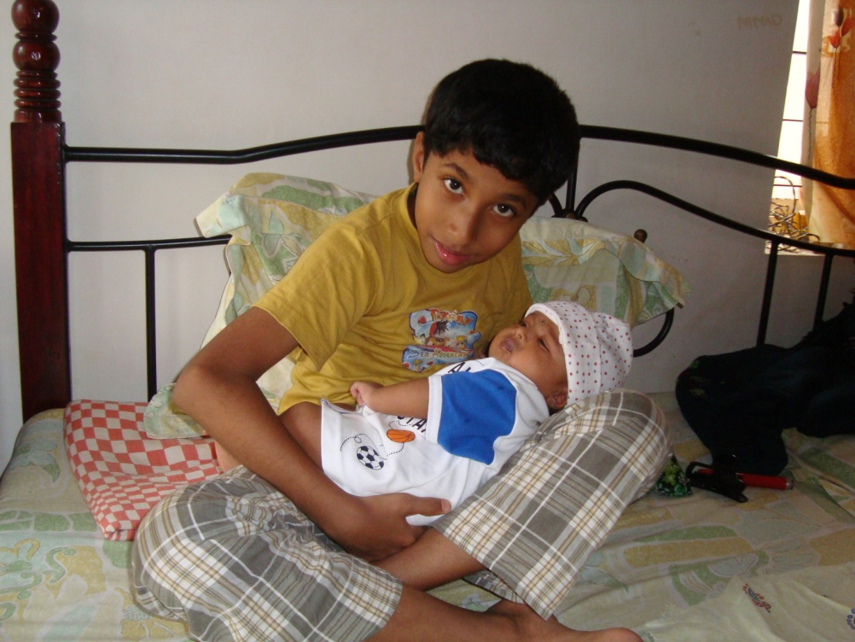
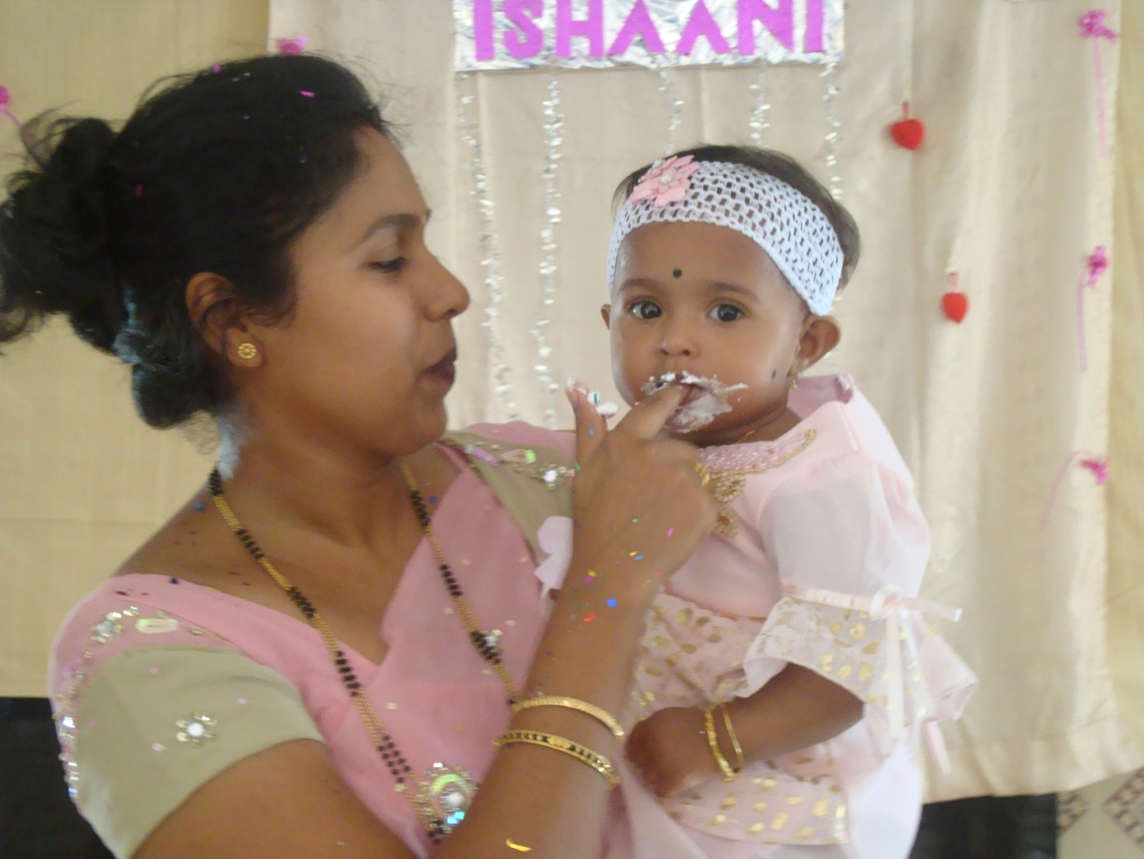
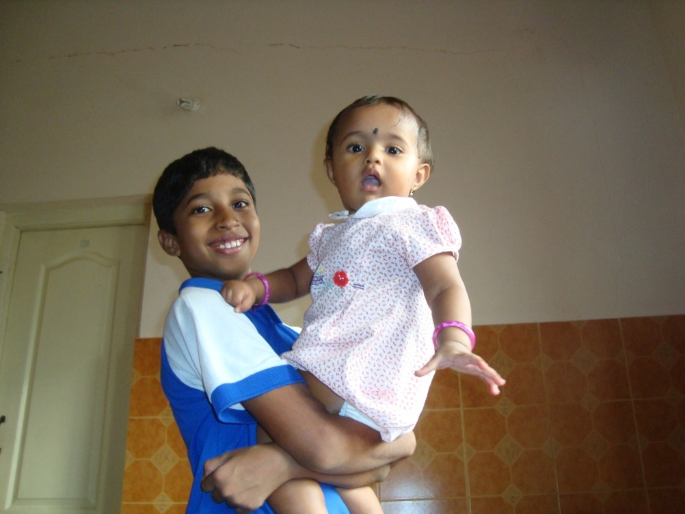
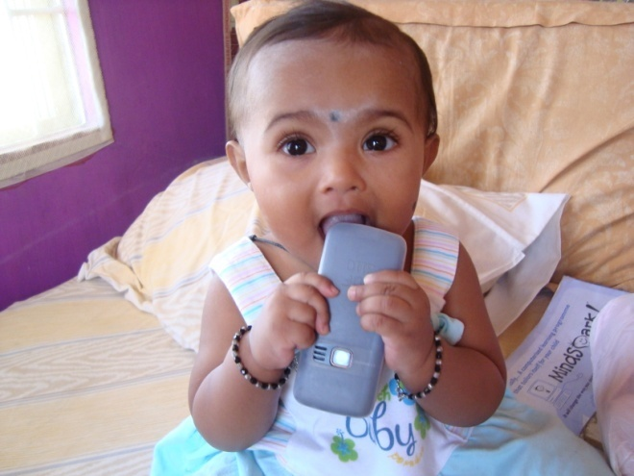
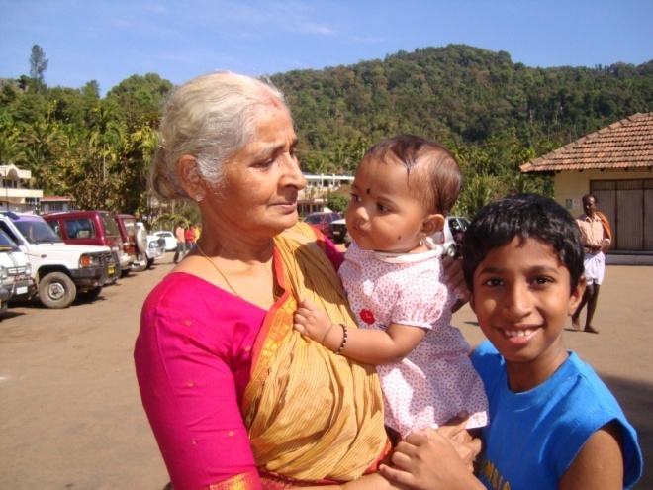
Her first birthday 

Slide 5
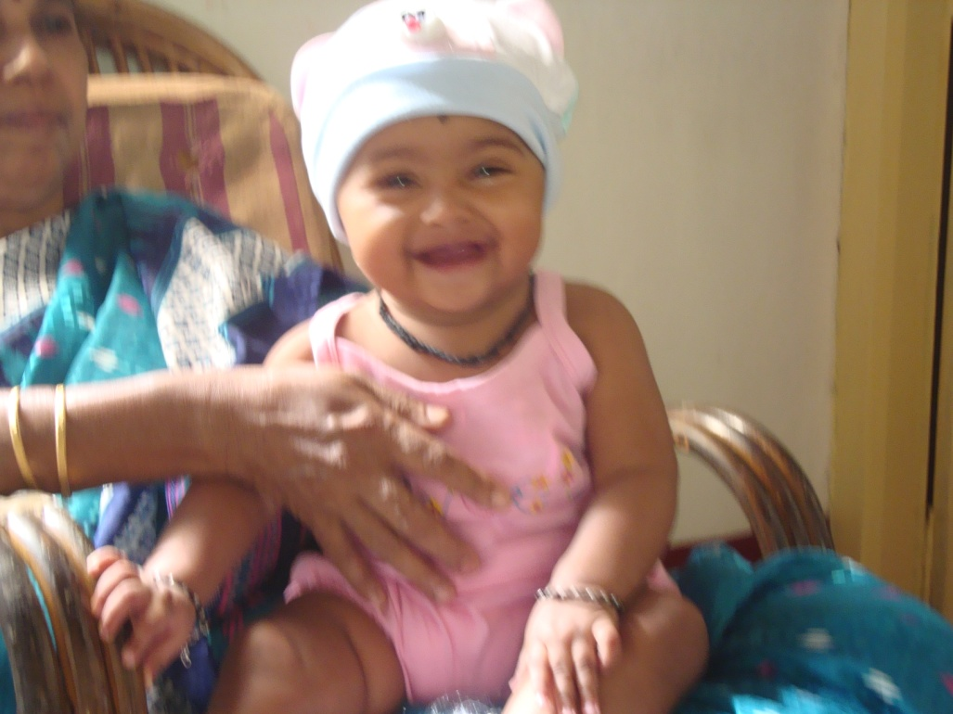
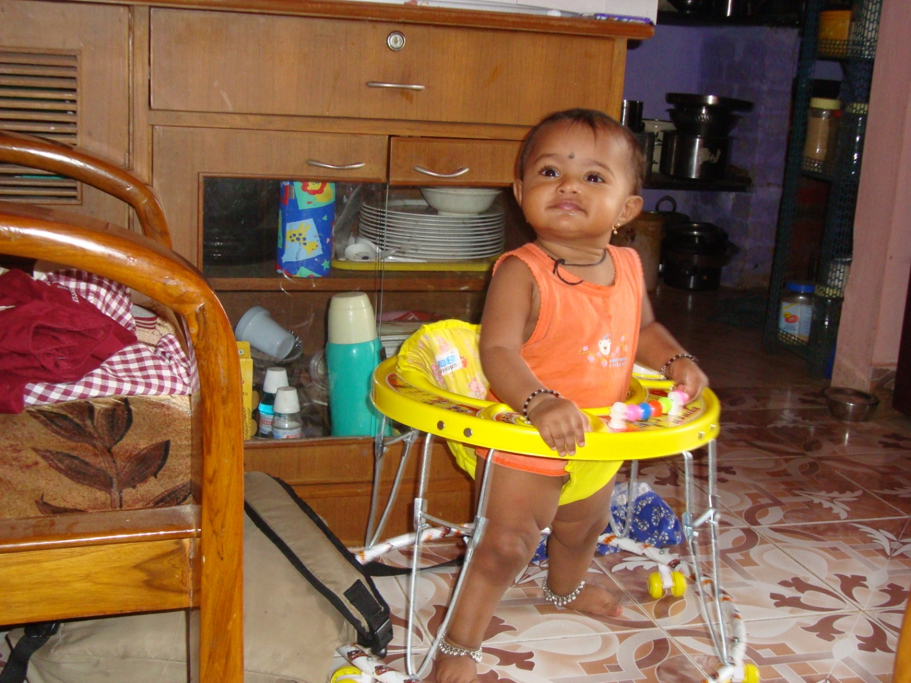
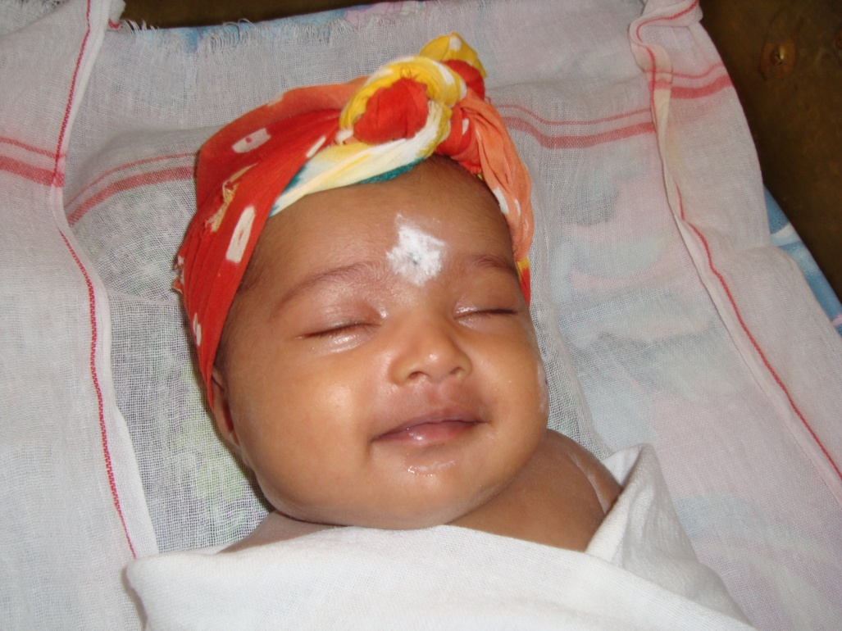
One smile, many joys

Slide 6
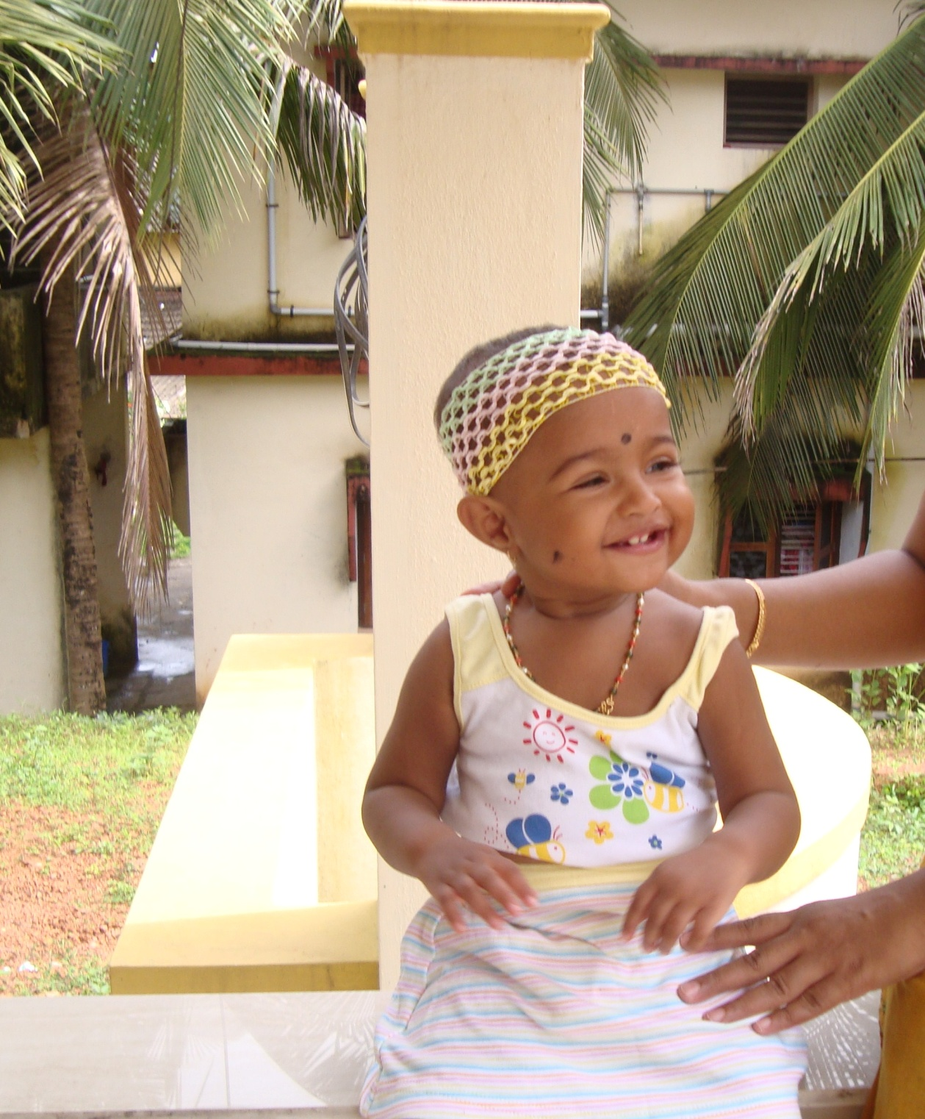
August 15th 2009
Age: 1 year 4 months
Place: Nitte
On her way to meet her baby cousin in Mangalore

Slide 7
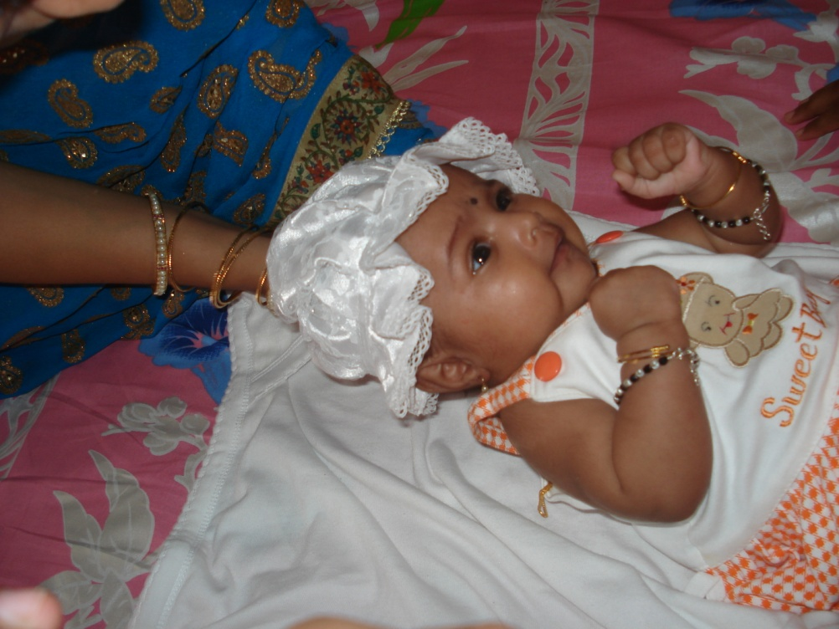
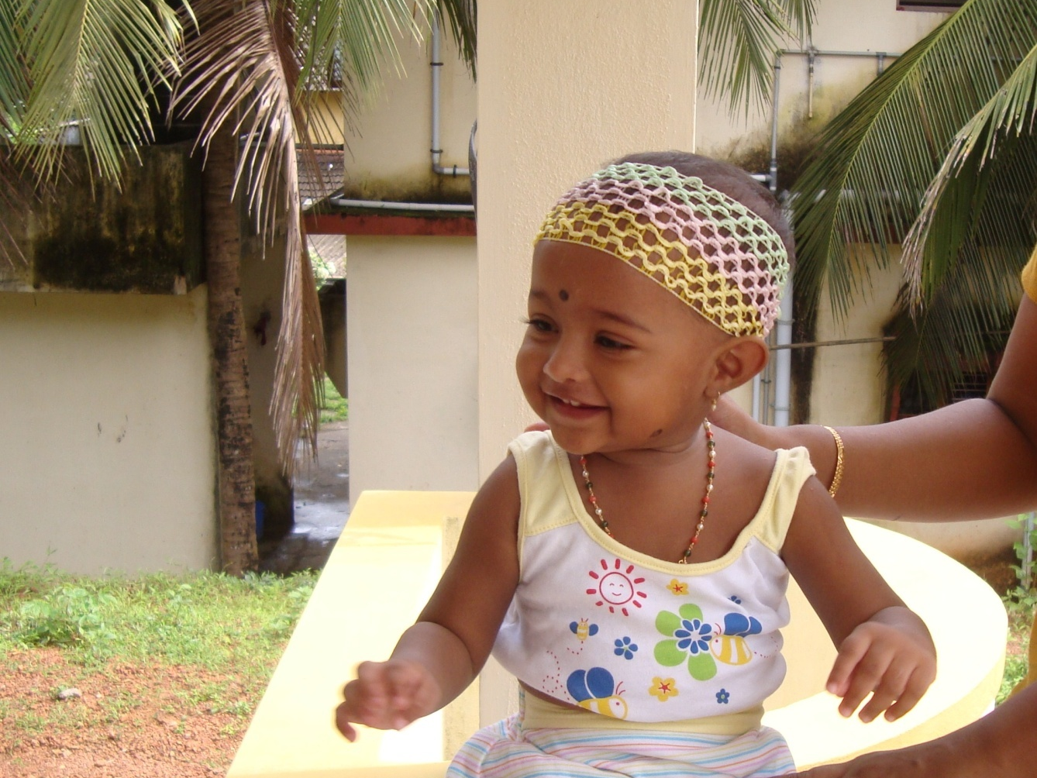
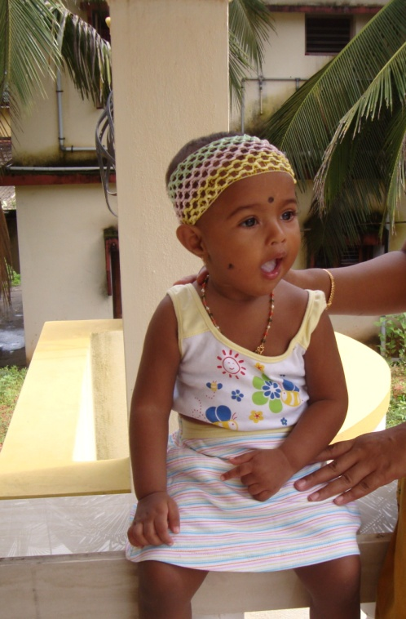
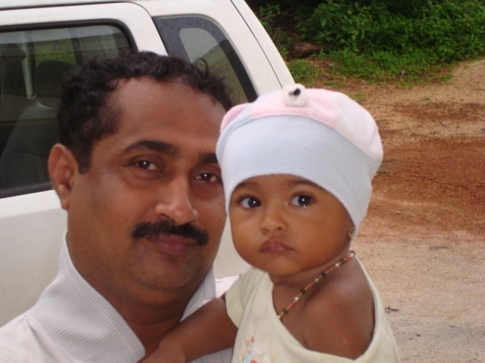
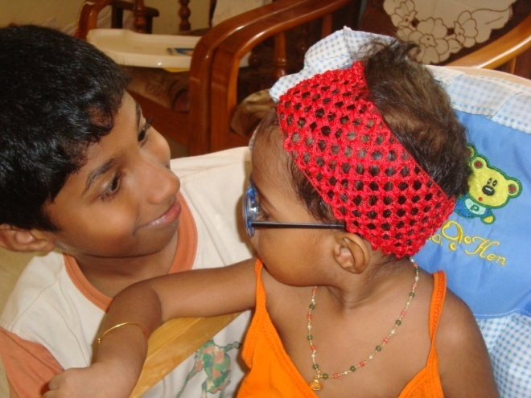

Slide 8
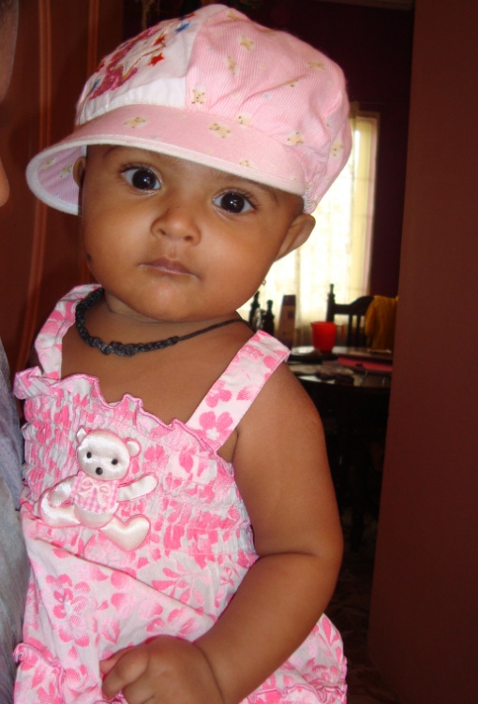
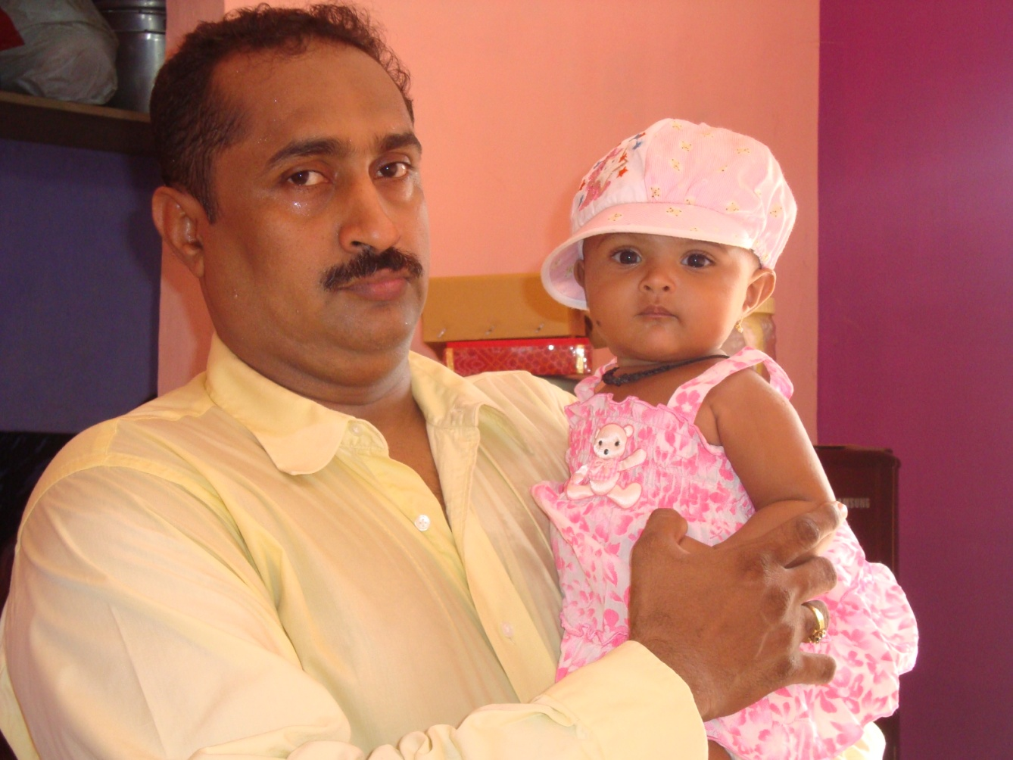
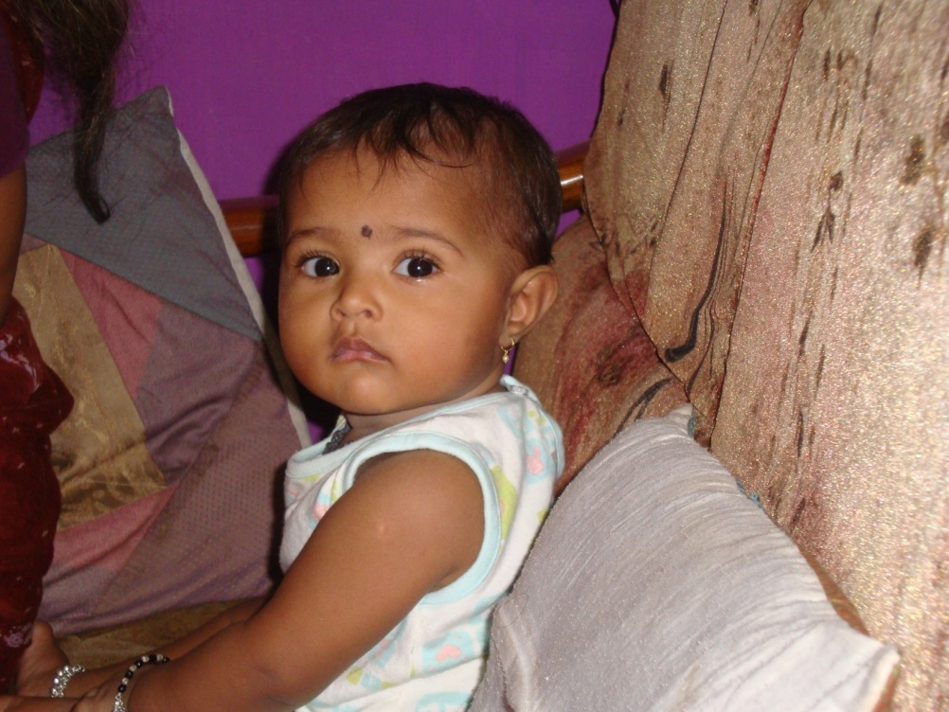
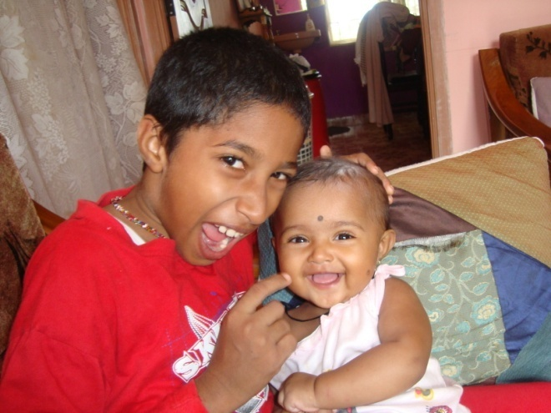
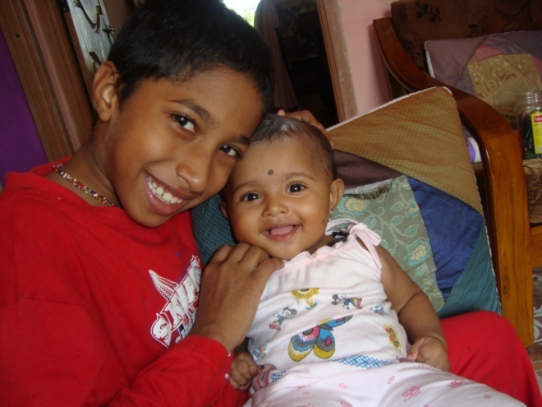

Slide 9
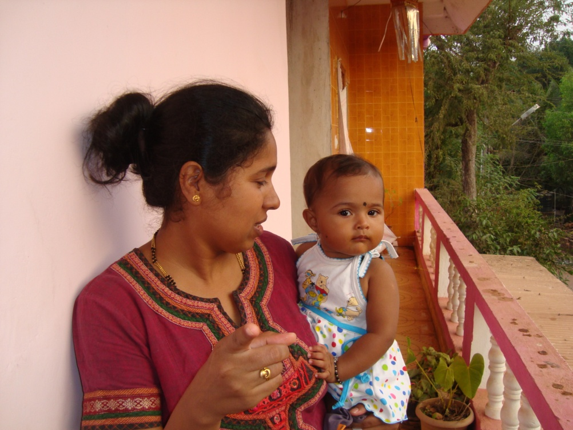
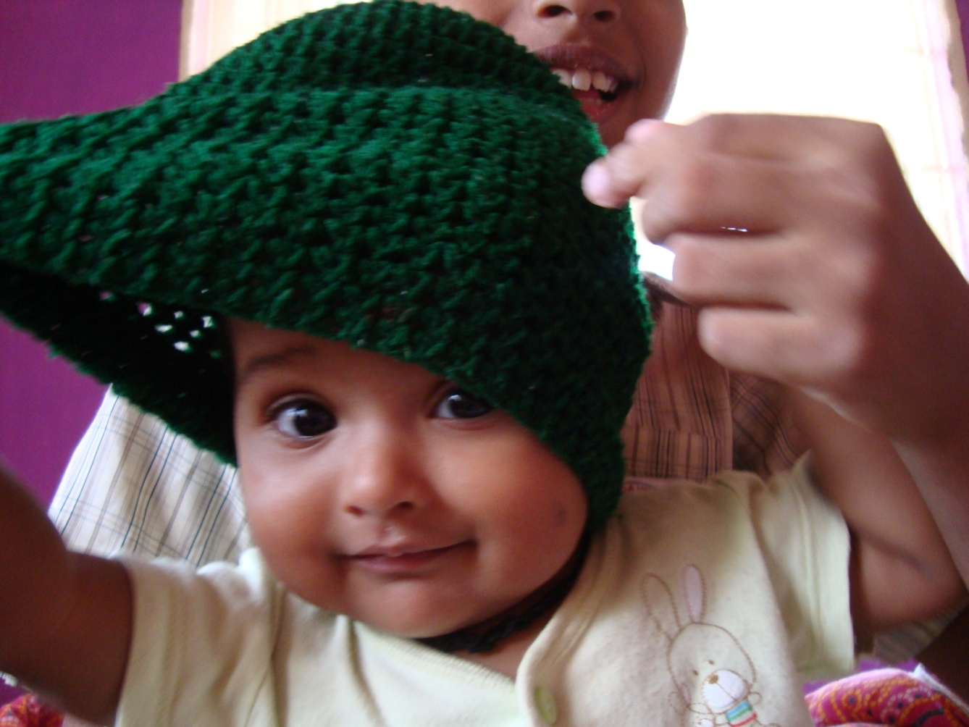
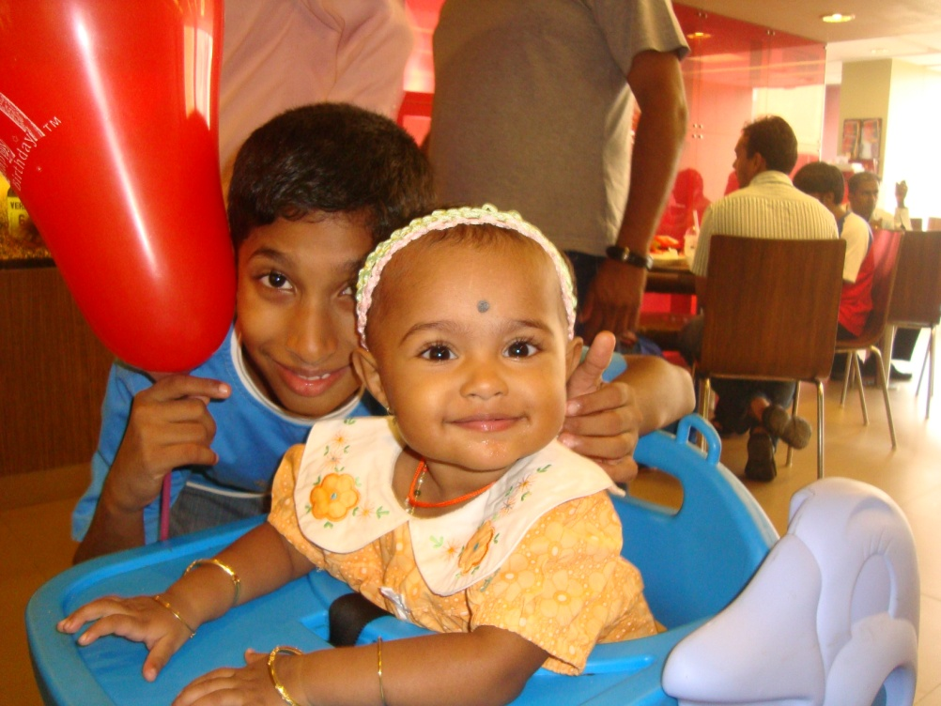
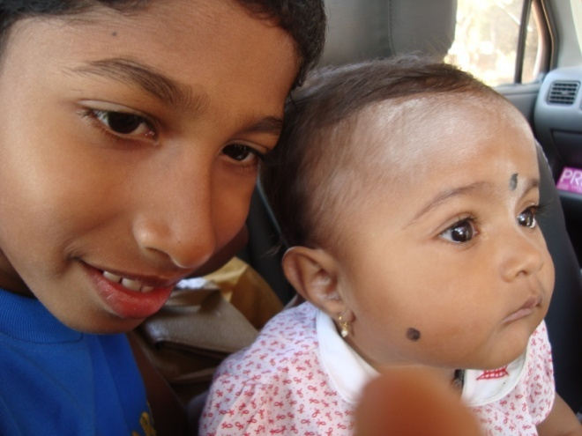
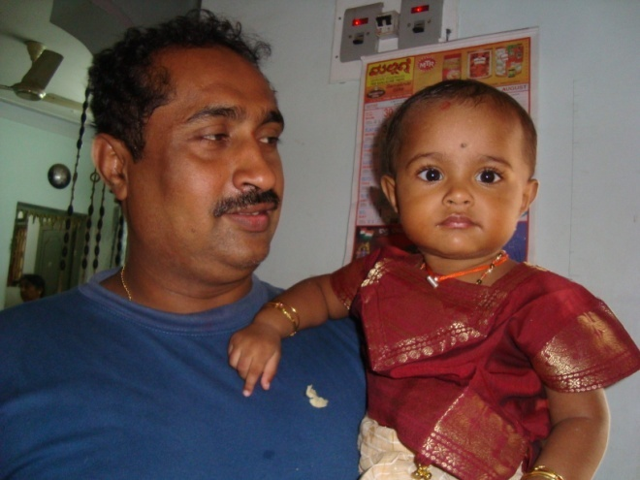

Slide 10
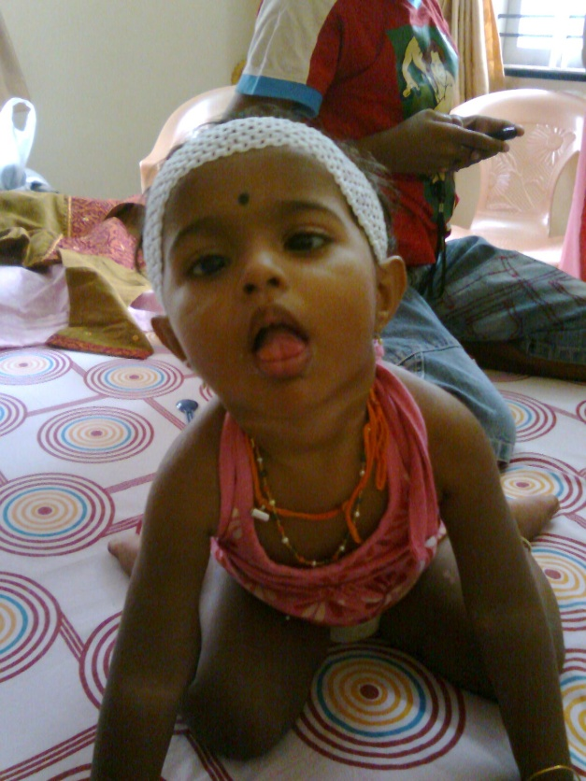
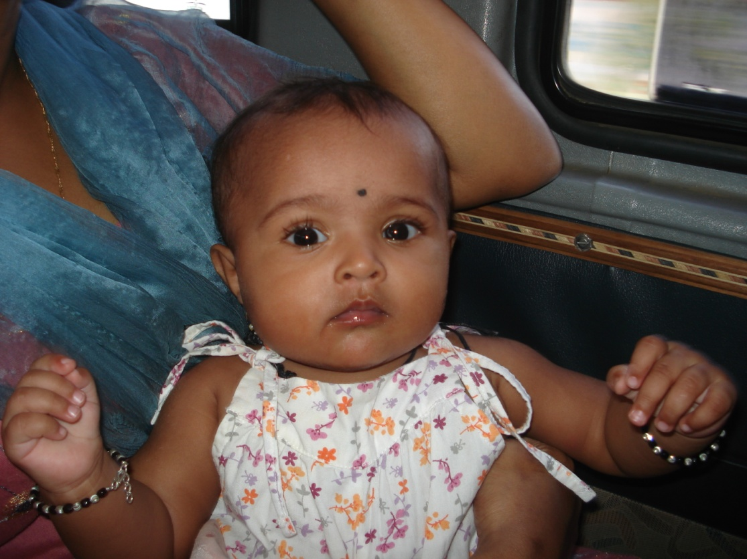
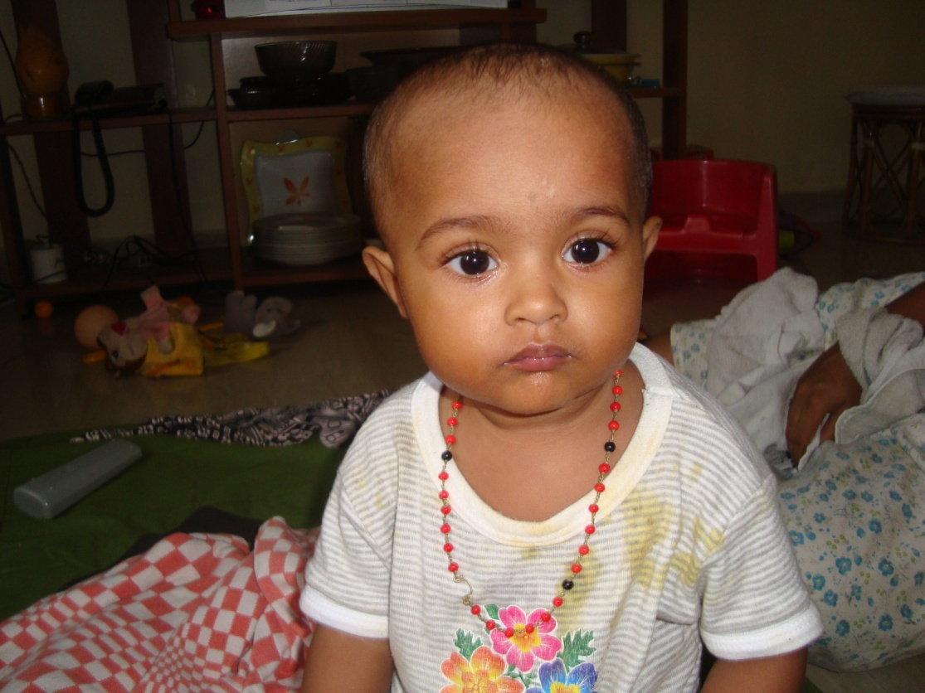
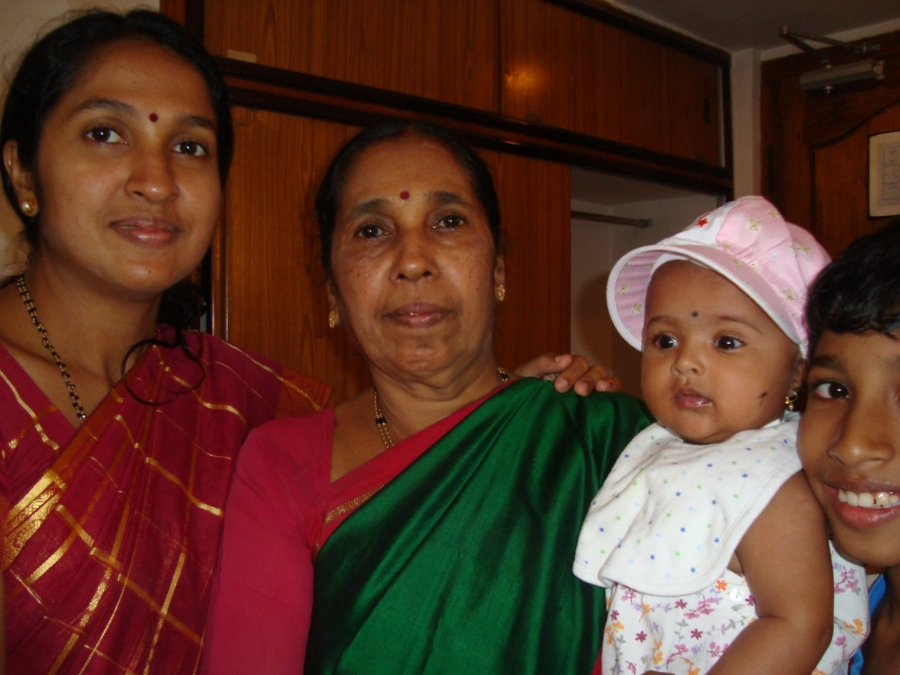
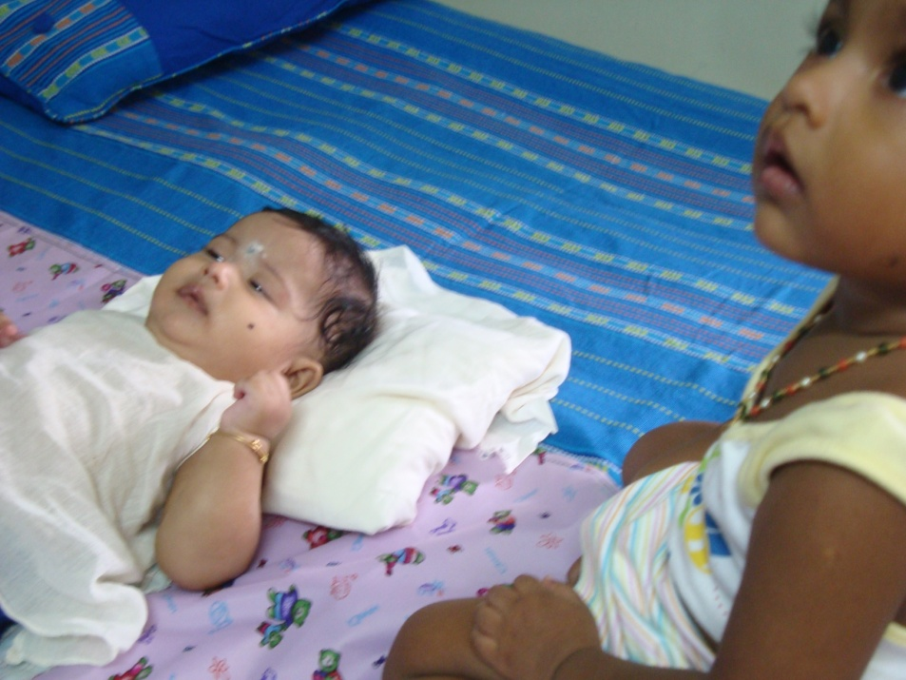

Slide 11
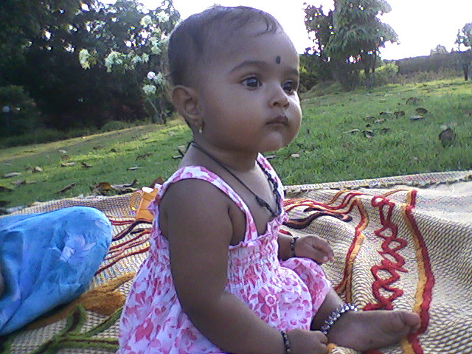
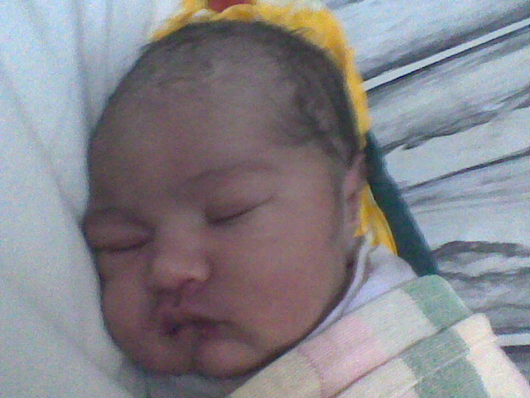
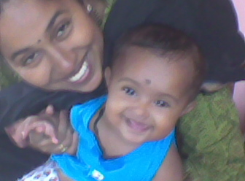
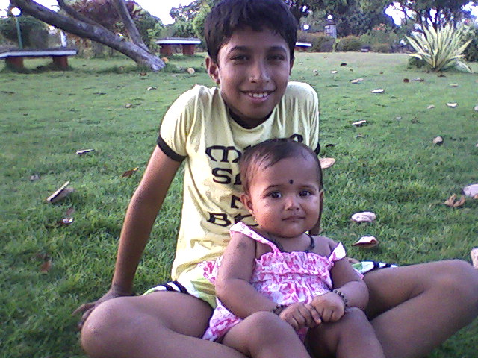

Slide 12
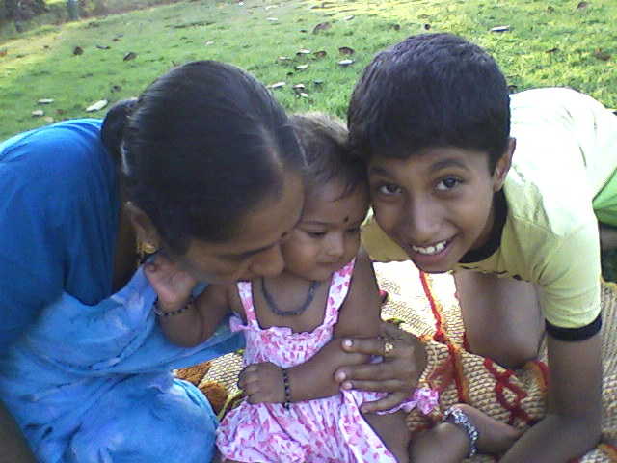
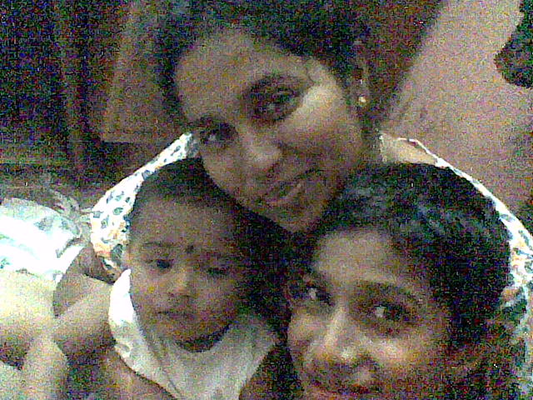
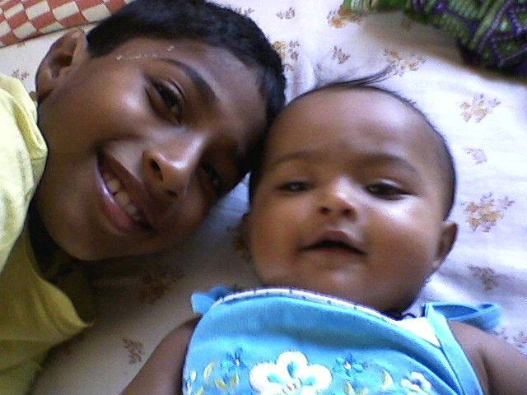

Slide 13
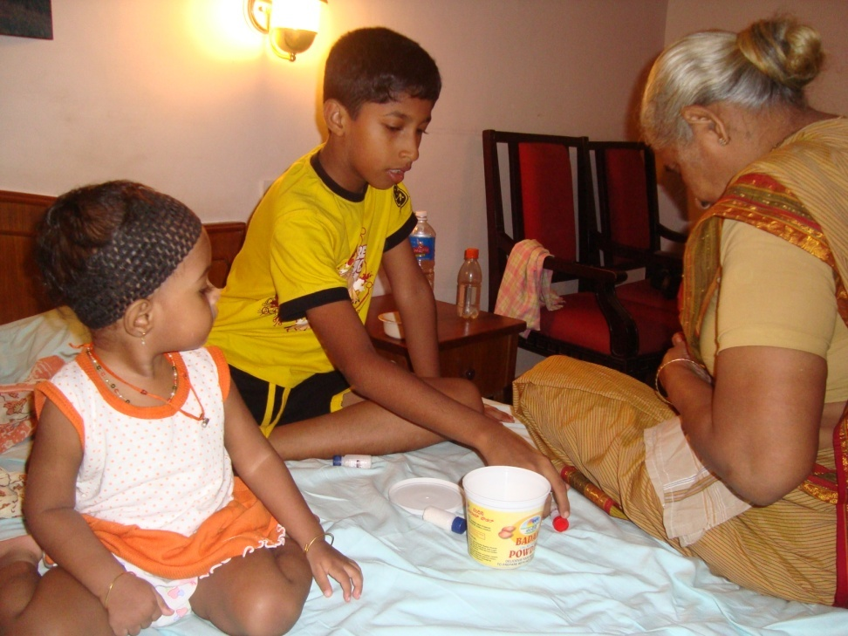
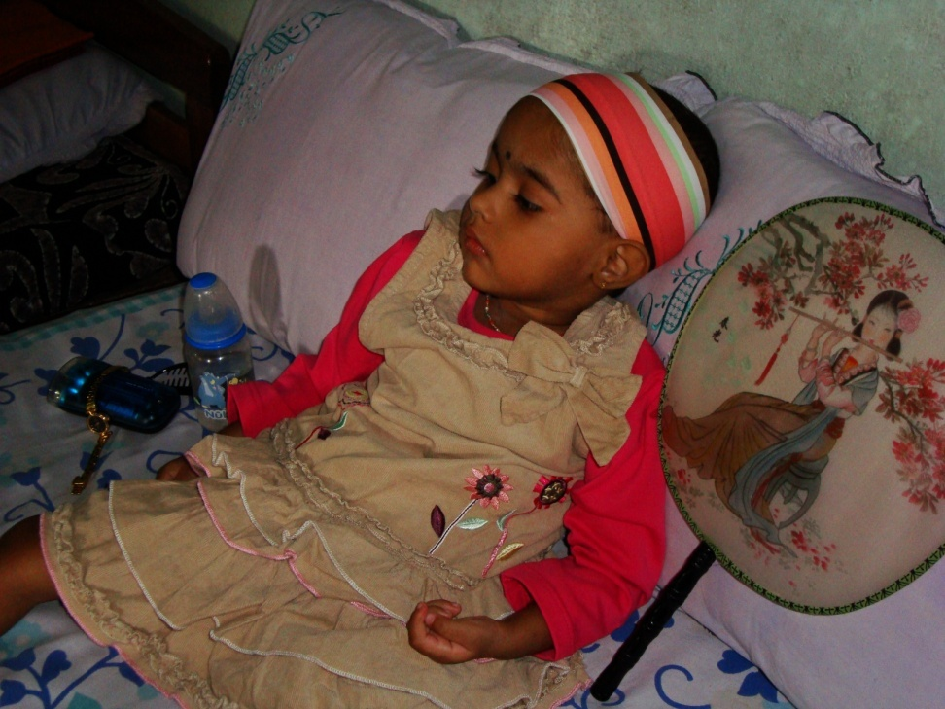
W-Sitting: Her favourite sitting position
Age:
Place: Mysore
After regression set in: Sitting with support
Age:
Place: Madikeri

Slide 14
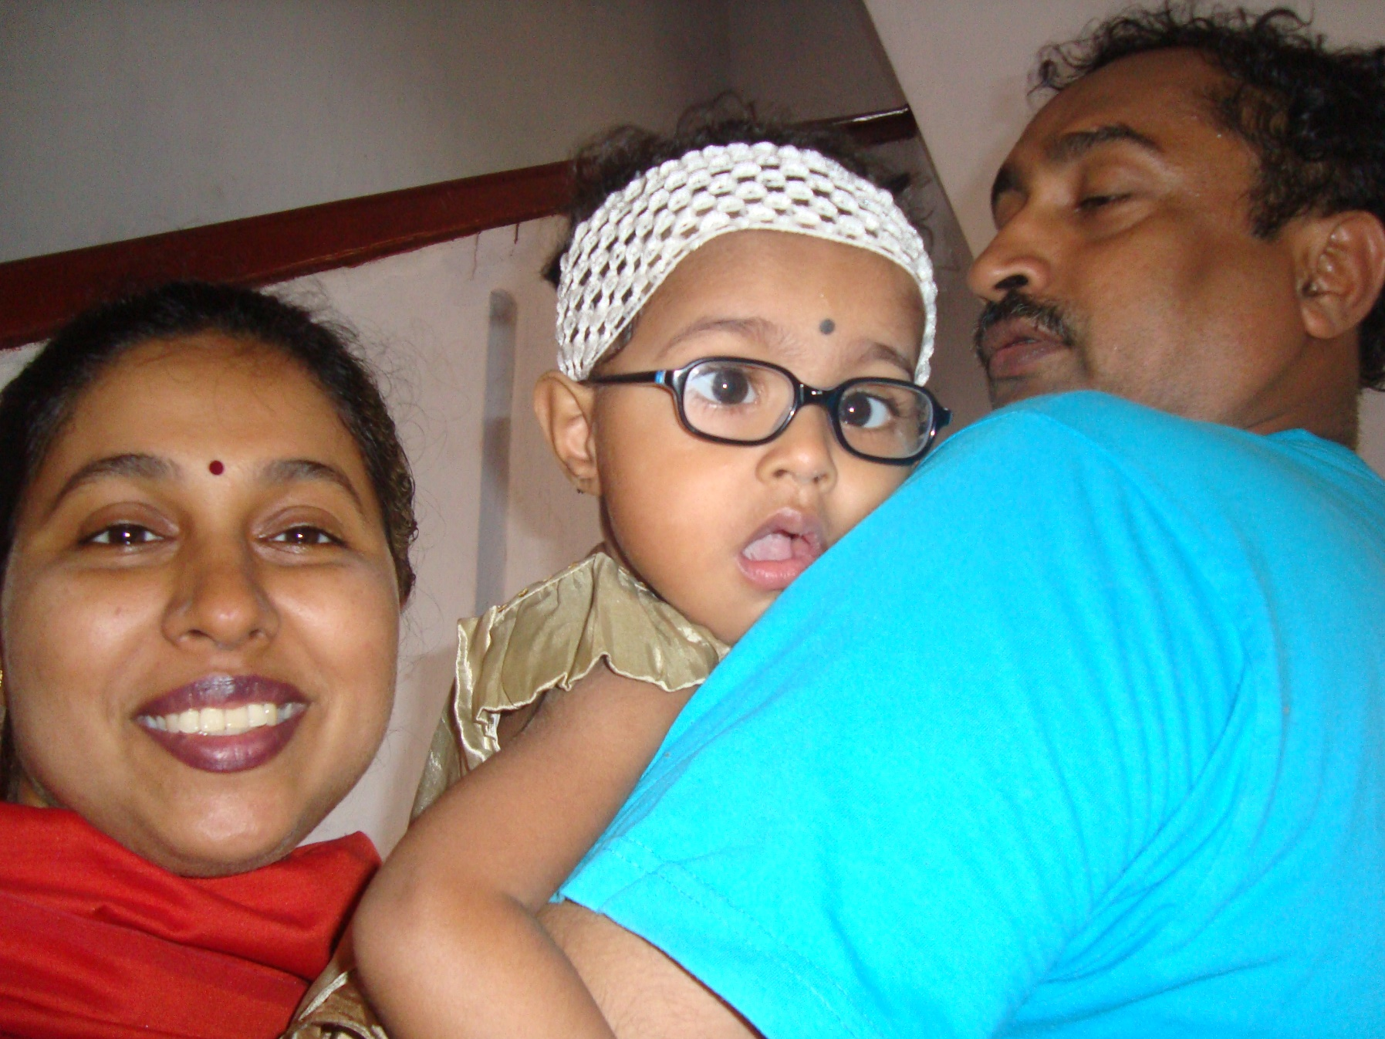
Her second birthday – April 10, 2009

Slide 15
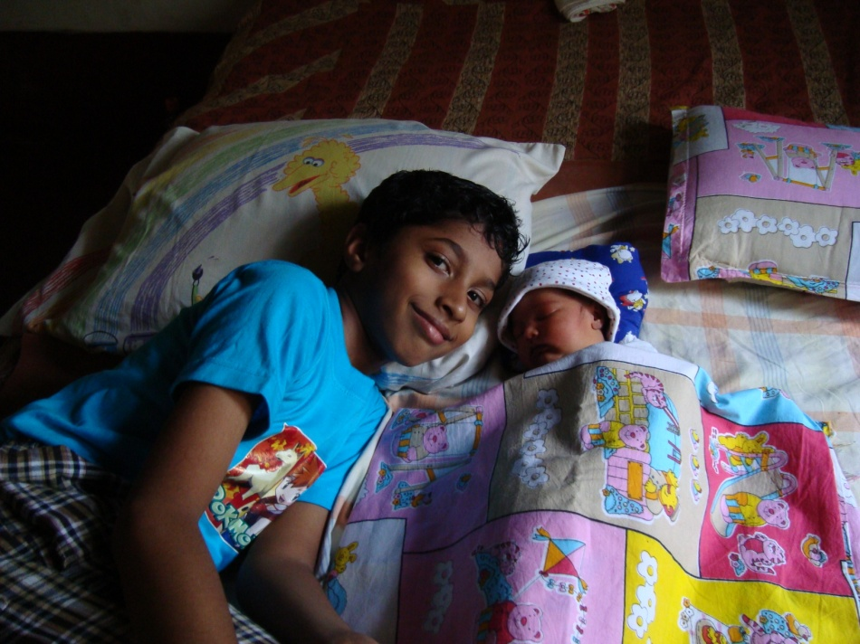
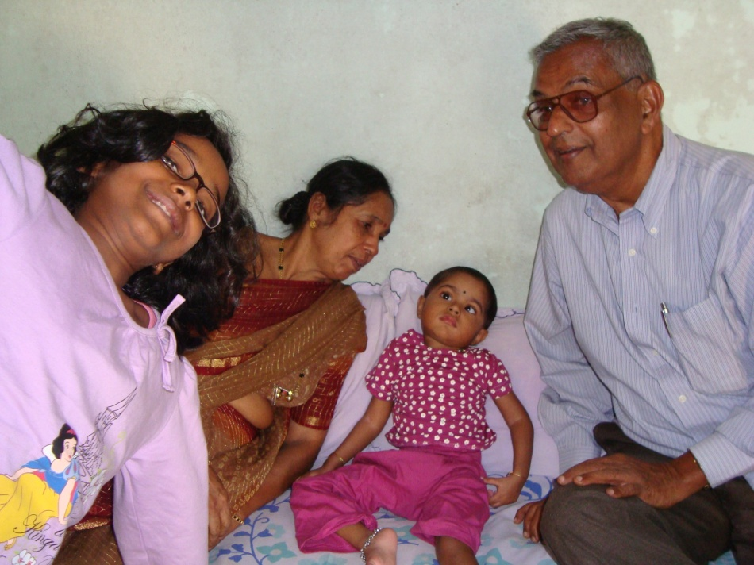
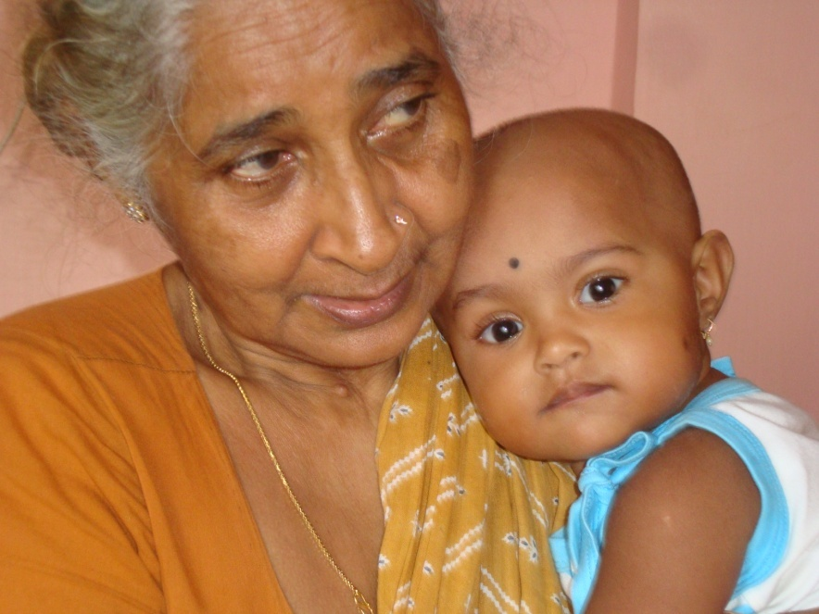
Random pics with her loved ones
1: With her grandparents (my parents)
2: With her grandmother, who doted on her (Girish’s mother)
3: With her bestest brother ever
3
1
2

Slide 16
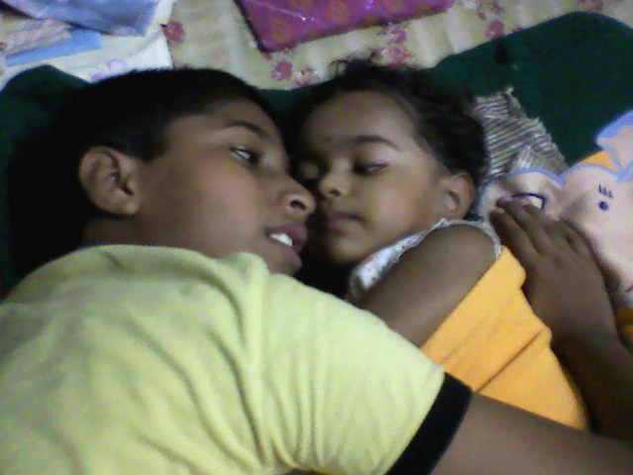
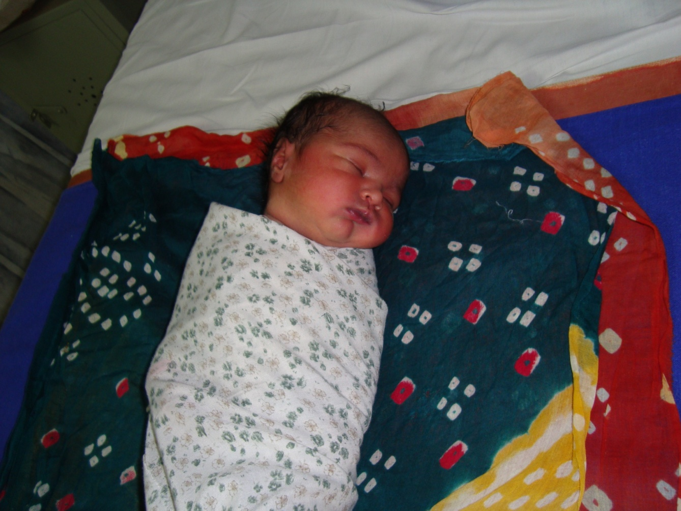

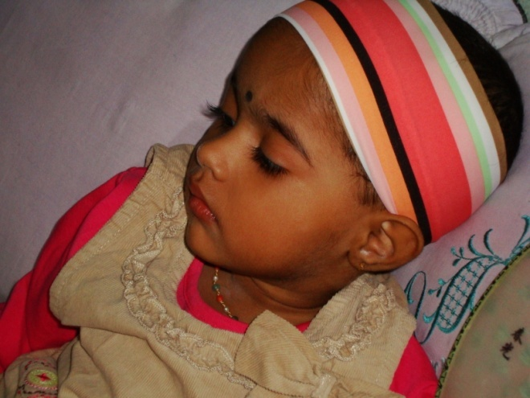
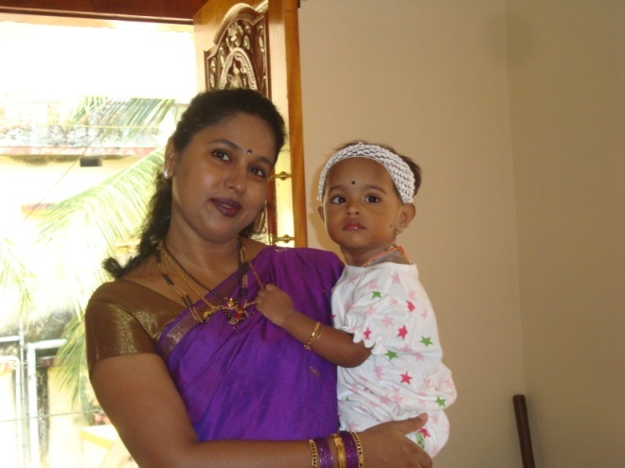

Slide 17
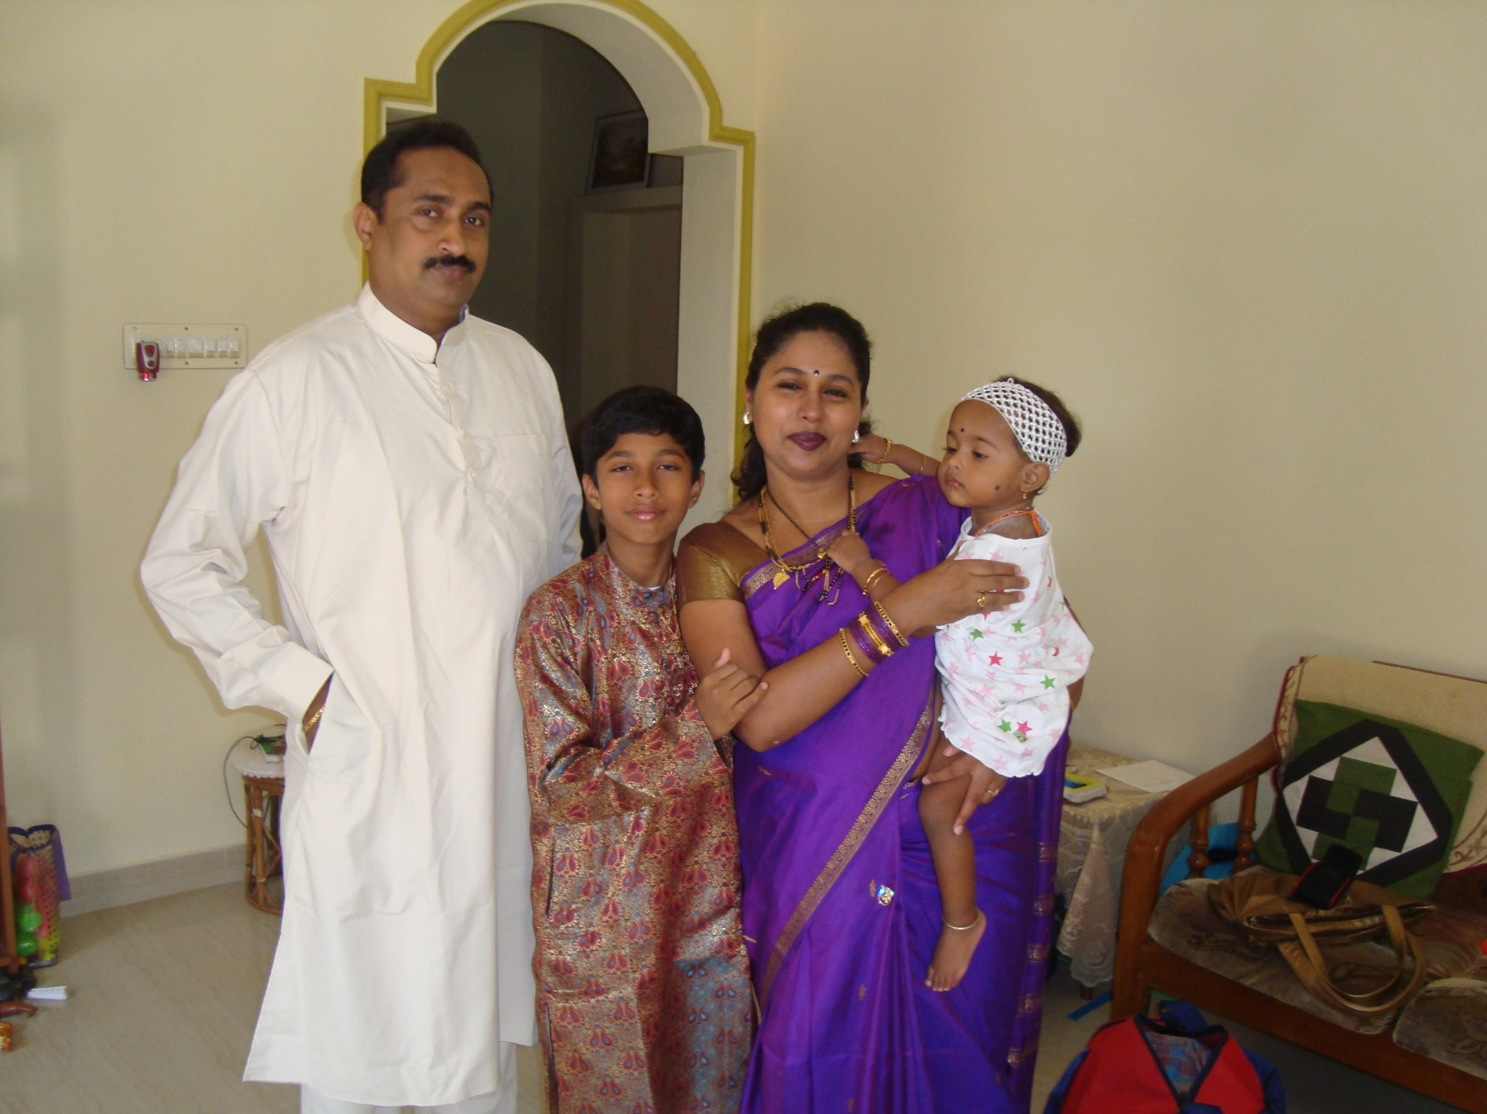
Awesome Foursome

Slide 18
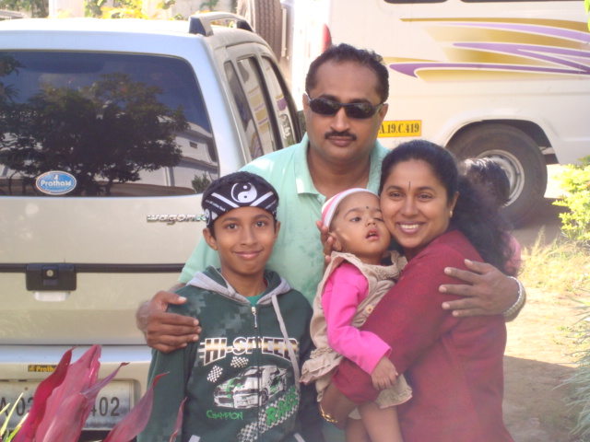


Ajji’s pet

Slide 19



Looking back, in time
Ishaani’s Album

Slide 20





Indigenous techniques to provide support to her neck and head

Slide 21





Slide 22




She was four years old here
Her daddy’s favorite

Slide 23

Our pretty iTani baby

Slide 24






Slide 25




Slide 26





Ishaani on the move, by air, train, bus and car

Slide 27






Slide 28

Age:
Location: Goa

Slide 29




Slide 30




Slide 31





Age: 7 years
Place: Manipal

Slide 32


Daddy’s girl!
Ninad’s doll!

Slide 33

She completes Us!
Age: 7 years
Place: Udupi

Slide 34


January 31st 2016

Slide 35

The G’s
Age: 8 years
Place: Halady

Slide 36




9th Birthday
Year: 2017
Place: Manipal

Slide 37
10th birthday!

Slide 38

Age: 10 years
Place: Karwar (Devbag Resort)

Slide 39

She never set foot on land, but her footprints are everywhere!

Slide 40



Our angel, thou art in heaven now
Ishaani’s Album

